Slide 1
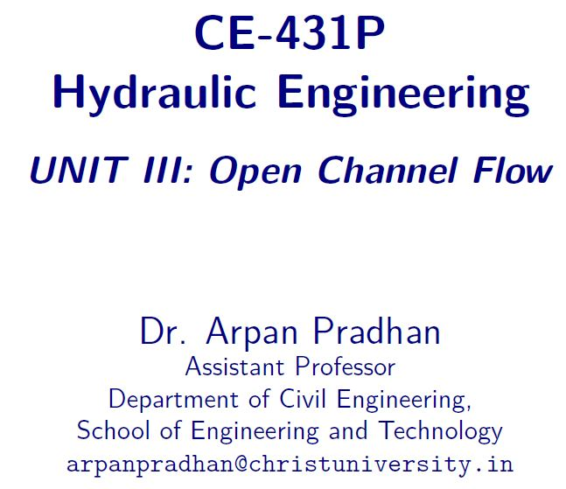

Slide 2
Contents
Most Economical Section

Slide 3
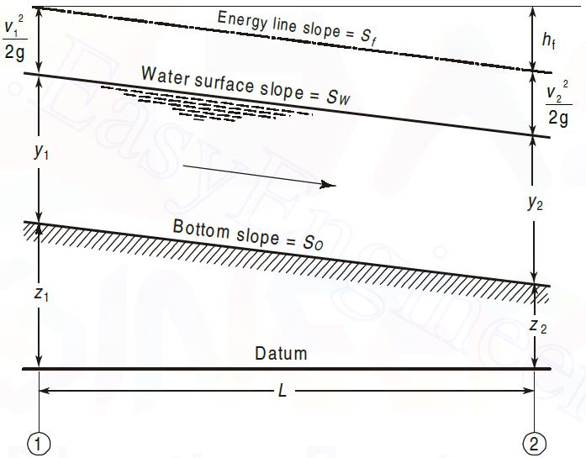
Uniform flow
Main features
The depth of flow, wetted area, velocity of flow and discharge are constant at every section along the channel reach.
The total energy line, water surface and the channel bottom are all parallel, that is, their slopes are all equal, or S_{f} = S_{w} = S₀ = S

Slide 4
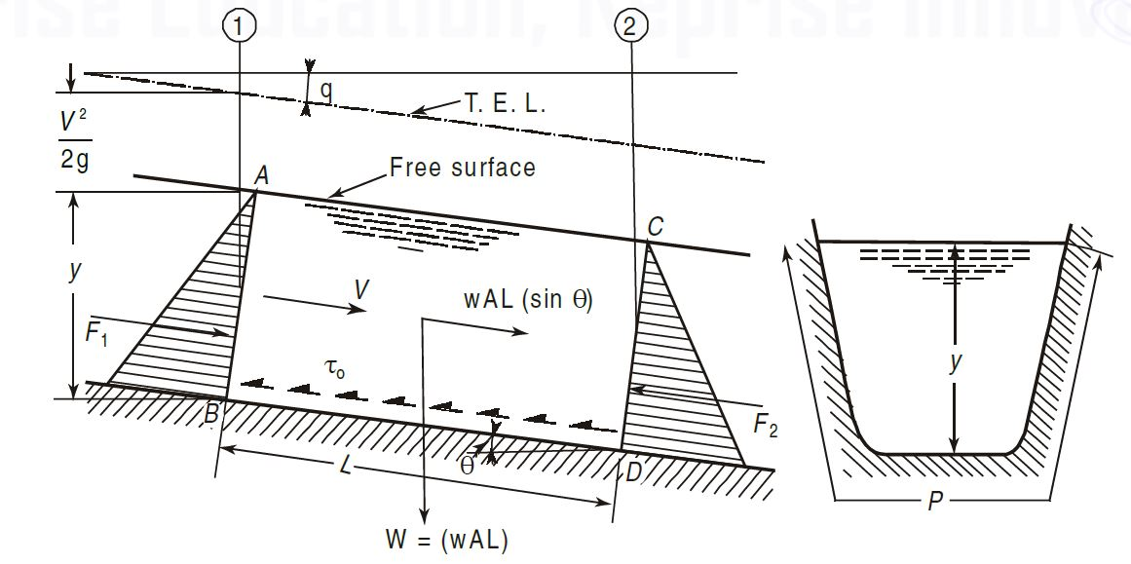
Uniform flow - Fundamental Eq.
The depth of a Uniform Flow is called as Normal Depth, denoted by y_{n}

Slide 5


Most economical section
A section of channel is said to be Economical, when the cost of construction of the channel is minimum.
Cost of Construction: Excavation and Lining
Wetted Perimeter to be Minimum, for a given Discharge
Best Section; Most Efficient Section
Design of Channel
A particular Discharge; for a given c/s area, A; slope of bed, S₀; and resistant coefficient is maximum.
$$V=C\sqrt{RS_{0}}$$
$$Q=AC\sqrt{RS_{0}}$$

Slide 6

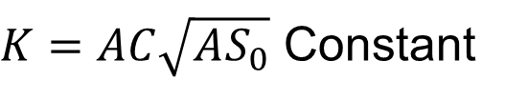
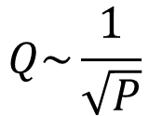
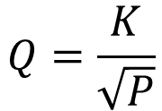
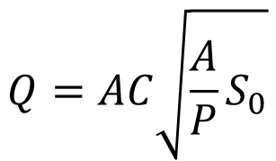
Most economical section
$$Q=AC\sqrt{RS_{0}}$$
$$Q=AC\sqrt{\frac{A}{P}S_{0}}$$
$$Q=\frac{K}{\sqrt{P}}$$
$K=AC\sqrt{AS_{0}}$ Constant
$$Q\sim \frac{1}{\sqrt{P}}$$
Q is Maximum when P is Minimum

Slide 7
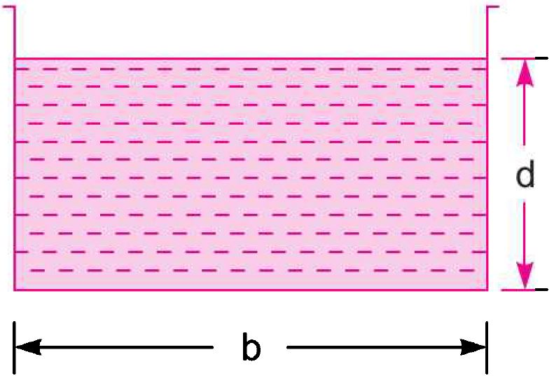
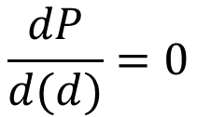
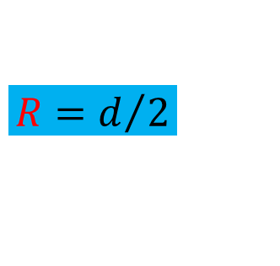

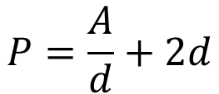
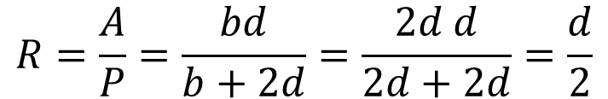




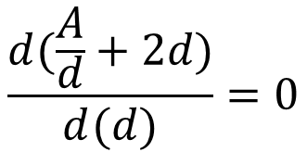
Most economical section – Rectangular C/s
$$A=bd$$
$$P=b+2d$$
Relationship b/w P and A
$$P=b+2d$$
$$P=\frac{A}{d}+2d$$
Most Economical Section
$$−{Ad}^{−2}+2=0$$
$$\frac{dP}{d(d)}=0$$
$$b=2d$$
$$R=\frac{A}{P}=\frac{bd}{b+2d}=\frac{2d d}{2d+2d}=\frac{d}{2}$$
$$\frac{d(\frac{A}{d}+2d)}{d(d)}=0$$
$$R=d/2$$

Slide 8
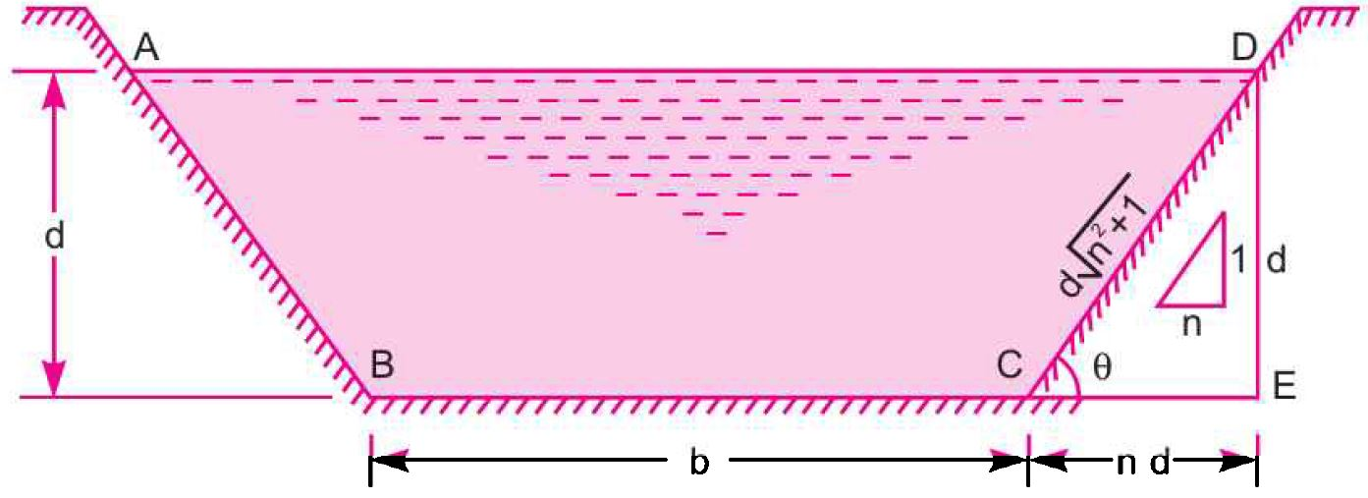
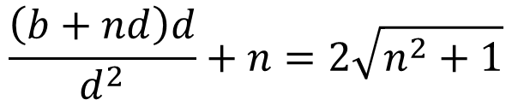

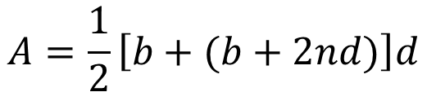


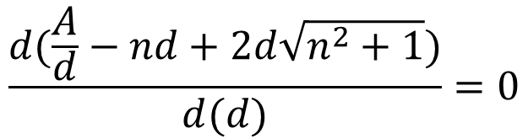
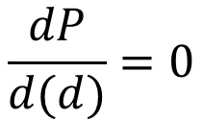
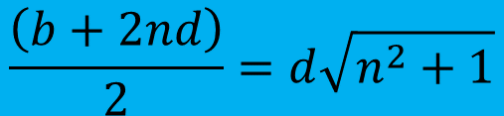

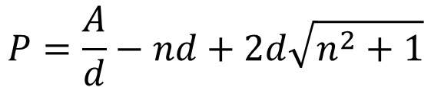
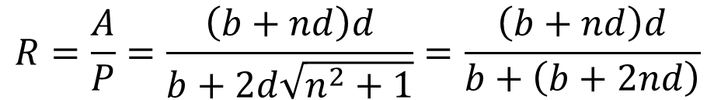

Most economical section – Trapezoidal C/s
$$A=\frac{1}{2}\left[b+(b+2nd)\right]d$$
$$A=\left(b+nd\right)d$$
$$P=b+2\sqrt{n^{2}d^{2}+d^{2}}$$
$$P=b+2d\sqrt{n^{2}+1}$$
Relationship b/w P and A
$$−{Ad}^{−2}−n+2\sqrt{n^{2}+1}=0$$
$$P=\frac{A}{d}−nd+2d\sqrt{n^{2}+1}$$
$$\frac{\left(b+nd\right)d}{d^{2}}+n=2\sqrt{n^{2}+1}$$
Most Economical Section
$$\frac{\left(b+2nd\right)}{2}=d\sqrt{n^{2}+1}$$
$$\frac{dP}{d(d)}=0$$
$$R=\frac{A}{P}=\frac{\left(b+nd\right)d}{b+2d\sqrt{n^{2}+1}}=\frac{\left(b+nd\right)d}{b+\left(b+2nd\right)}$$
$$\frac{d(\frac{A}{d}−nd+2d\sqrt{n^{2}+1})}{d(d)}=0$$
$$R=d/2$$

Slide 9
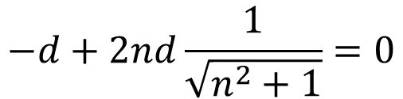
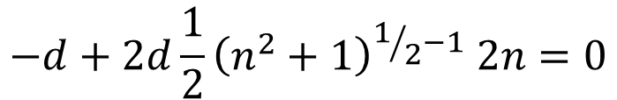
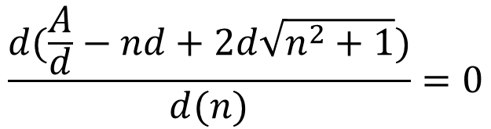
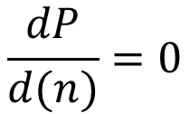
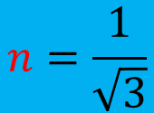

Most economical section – Trapezoidal C/s
$$A=\frac{1}{2}\left[b+(b+2nd)\right]d$$
$$A=\left(b+nd\right)d$$
$$P=b+2\sqrt{n^{2}d^{2}+d^{2}}$$
$$P=b+2d\sqrt{n^{2}+1}$$
Relationship b/w P and A
$$P=\frac{A}{d}−nd+2d\sqrt{n^{2}+1}$$
$$−d+2d\frac{1}{2}{\left(n^{2}+1\right)}^{1/2−1} 2n=0$$
$$−d+2nd\frac{1}{\sqrt{n^{2}+1}}=0$$
Most Economical Section
$$\frac{dP}{d(n)}=0$$
$$2n=\sqrt{n^{2}+1}$$
$$\frac{d(\frac{A}{d}−nd+2d\sqrt{n^{2}+1})}{d(n)}=0$$
$$n=\frac{1}{\sqrt{3}}$$

Slide 10

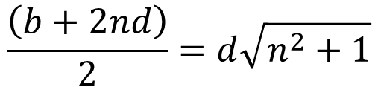


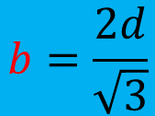
Most economical section – Trapezoidal C/s
$$A=\frac{1}{2}\left[b+(b+2nd)\right]d$$
$$A=\left(b+nd\right)d$$
$$P=b+2\sqrt{n^{2}d^{2}+d^{2}}$$
$$P=b+2d\sqrt{n^{2}+1}$$
Relationship b/w P and A
$$\frac{\left(b+2nd\right)}{2}=d\sqrt{n^{2}+1}$$
$$P=\frac{A}{d}−nd+2d\sqrt{n^{2}+1}$$
$$b=\frac{2d}{\sqrt{3}}$$
Most Economical Section
$$\frac{dP}{d(n)}=0$$
$$P=b+2d\sqrt{n^{2}+1}$$
$$n=\frac{1}{\sqrt{3}}$$
$$P=3b$$

Slide 11
numerical
Q1. A rectangular channel of width, 4 m is having a bed slope of 1 in 1500. Find the maximum discharge through the channel. Take C=50.

Slide 12
numerical
Q2. A rectangular channel carries water at the rate of 400 lit/s when bed slope is 1 in 2000. Find the most economical dimensions of the channel if C=50.

Slide 13
numerical
Q3. A rectangular channel 4 m wide has depth of water 1.5 m. The slope of the bed of the channel is 1 in 1000 and value if Chezy’s constant, C=55. It is desired to increase the discharge to a maximum by changing the dimensions of the section for constant area of c/s, slope of bed and roughness of the channel. Find the dimensions of the channel and increase in discharge.

Slide 14
numerical
Q4. A trapezoidal channel has side slopes of 1H:2V and the slope of the bed is 1 in 1500. Area of section is 40 m². Find the dimensions of the section if it is most economical. Determine the discharge of the most economical section; if C=50.

Slide 15
numerical
Q5. A trapezoidal channel with side slopes of 1 in 1 has to be designed to convey 10 m³/s at a velocity of 2 m/s so that the amount of concrete lining for the bed and sides is the minimum. Calculate the area of lining required for one metre length of canal.

Slide 16
numerical
Q6. A trapezoidal channel has side slopes of 1 in 1. It is required to discharge 13.75 m³/s of water with a bed gradient of 1 in 1000. If unlined, the value of Chezy’s C is 44 and 60 if lined with concrete. The cost per m³ of the excavation is four times the cost of m² of lining. The channel is to be the most efficient one. Find whether the lined canal or the unlined canal will be cheaper. What will be the dimensions of that economical canal.

Slide 17
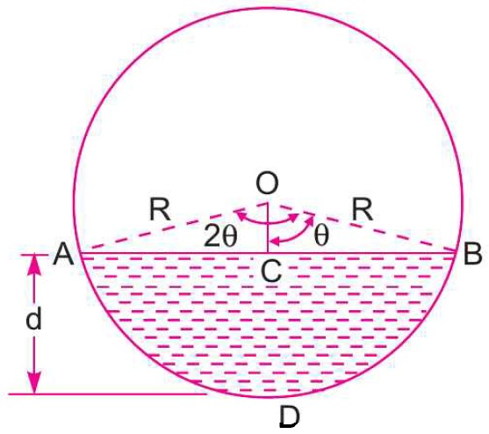
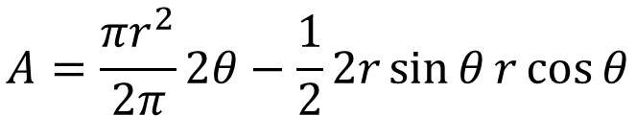
Most economical section – Circular C/s
$$P=\frac{2πr}{2π}2θ=2rθ$$
$$A=\frac{πr^{2}}{2π}2θ−\frac{1}{2}2r\sin{θ}r\cos{θ}$$
$$A=r^{2}θ−\frac{r^{2}\sin{2θ}}{2}=r^{2}\left(θ−\frac{\sin{2θ}}{2}\right)$$
Relationship b/w P and A
$$R=\frac{A}{P}=\frac{r^{2}\left(θ−\frac{\sin{2θ}}{2}\right)}{2rθ}$$
$$R=\frac{r}{2θ}\left(θ−\frac{\sin{2θ}}{2}\right)$$

Slide 18
numerical
Q7. Find the discharge through a circular pipe of diameter 3 m, if the depth of water in the pipe is 1 m and the pipe is laid at a slope of 1 in 1000. Take the value of C as 70.

Slide 19
numerical
Q8. Calculate the quantity of water that will be discharged at a uniform depth of 0.9 m in a 1.2 m diameter pipe which is laid at a slope 1 in 1000. Assume C as 58.

Slide 20


